Slide 1
Merge sort
Liam Callahan

Slide 2
Divide and conquer
Divide the array into 2 arrays: A & B
Divide array A & B until they’re compromised of single unit subarrays
Starting from left to right compare the first number to the second, putting the smaller number to the left in array now consisting of 2 numbers for both array set A & B
Take the next number for both array set A & B and compare it to the new 2 number array
Compare the “next” number to each number in the 2 number array until you find a number bigger than it and your “next number” or find out your number is bigger than the others
Put your “next number” in the spot it belongs to, either the end because it was the biggest or in front of one of the numbers it was smaller than
This gives you a subarray in both A & B consisting of 3 number that’re sorted
Repeat until all the numbers in Array A & B are sorted and combined into an array again
Compare each number in array B to array A until each number is sorted into one big array again

Slide 3
[45,8,32,54,76,3,10,34,20]
A
[45,8,32,54]
B
[76,3,10,34,20]
Divide array into 2 arrays
[45] [8] [32] [54]
[76] [3] [10] [34] [20]
Split into single units
45 > 8
76 > 3
[8,45] [32] [54]
[3,76] [10] [34] [20]
Compare first two numbers and combine
8 < 32 | 45 > 32
3 < 10 | 76 > 10
[8,32,45] [54]
[3,10,76] [34] [20]
Compare the next number to your two numbers and combine
8 < 54 | 32 < 54 | 45 < 54
3 < 34 | 10 < 34 | 76 > 34
[8,32,45,54]
[3,10,34,76] [20]
Compare the next number to your 3 numbers and combine
3 < 20 | 10 < 20 | 34 > 20
[8,32,45,54]
[3,10,20,34,76]
Repeat for your 4 numbers in array B
8 > 3
[3,8,32,45,54]
Compare each number in array B to array B until there’s one greater than
8 < 20 | 32 > 20
[3,8,20,32,45,54]
Repeat until fully sorted
[3,8,10,20,32,34,45,54,76]

Slide 4
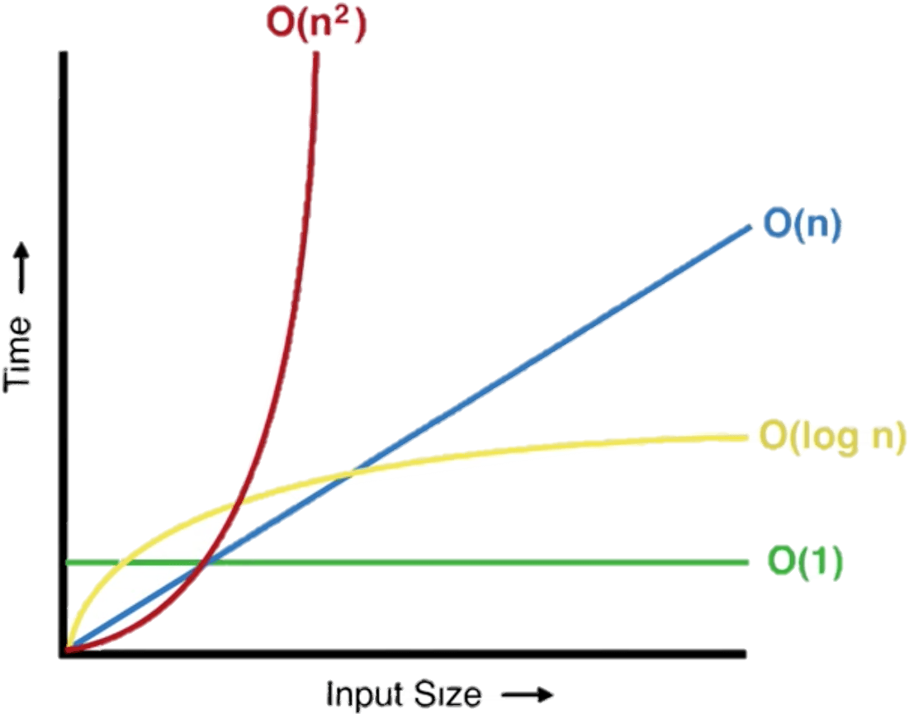
BIG-O
Best and Worst case scenario are the same due to no change because even if it’s sorted the same steps happen regardless
Due to the division of the array happening until each subarray has one element, the time is proportional how many times it can be divided → O(log ​n)
During the merging phase each
number is compared to another
one at a time until the array is
sorted → O(n)
Division + Merging = O(n log n)

Slide 5
Java code implementation
private static void merge(int[] array, int[] left, int[] right) {
int leftIndex = 0, rightIndex = 0, mergeIndex = 0;
// Merge the arrays while both halves have elements
while (leftIndex < left.length && rightIndex < right.length) {
if (left[leftIndex] <= right[rightIndex]) {
array[mergeIndex] = left[leftIndex];
leftIndex++;
} else {
array[mergeIndex] = right[rightIndex];
rightIndex++;
}
mergeIndex++;
}
// If there are remaining elements in left[], copy them
while (leftIndex < left.length) {
array[mergeIndex] = left[leftIndex];
leftIndex++;
mergeIndex++;
}
// If there are remaining elements in right[], copy them
while (rightIndex < right.length) {
array[mergeIndex] = right[rightIndex];
rightIndex++;
mergeIndex++;
}
}
public static void main(String[] args) {
int[] array = {38, 27, 43, 3, 9, 82, 10};
//Call the mergeSort method
mergeSort(array);
}
public static void mergeSort(int[] array) {
// Check if the array has more than one element
if (array.length <= 1) {
return;
}
// Split the array into two halves
int mid = array.length / 2;
// Create subarrays
int[] left = new int[mid];
int[] right = new int[array.length - mid];
//Copy array halves into arrays left and right
System.arraycopy(array, 0, left, 0, mid);
System.arraycopy(array, mid, right, 0, array.length-mid);
// Recursively sort each half
mergeSort(left);
mergeSort(right);
// Merge the sorted halves
merge(array, left, right)
}

Slide 6
Real world examples
Since the complexity of the algorithm doesn’t change in it’s best or worst case scenarios it is usually used on high volume data sets
A lot of merge sorting is used when dealing with large datasets that can’t fit on the memory which is when the division of the dataset proves instrumental
Merge sorting is especially useful when dealing with parallel computing where each of the divisions can be handled in at the same time in parallel
Since merge sorting already divides arrays into subarrays it makes it especially easy to introduce different arrays and combine multiple datasets to have them sorted in a single list

Slide 7
Thank you

